Slide 1
Condition monitoring & Management Systems for Agricultural Crops.
Created by Preetam & Kavan

Slide 2
What this PPT will cover?
Introduction
Modeling of the System
Modeling of the System with varying Fan RPM
Design of the Project
Analysis of the Project
Sensor Inaccuracies
Actuator Behavior
Response Time of the system.

Slide 3
INTRODUCTION
Due to the severe weather conditions lots of crops has been damaged over the past several years, which also has impacted greatly on the economy of several countries.
The climatic condition control inside this greenhouse is one of the best examples for the cyber physical systems.
We have accordingly modelled, designed and analysed the system which will control the temperature in the green house plantation.

Slide 4
What all we have done?
We have used FSM to model the system.
This FSM have three states i.e. ‘Idle’, ‘Cooling’ and ‘Heating.’
We used Temperature for sensing the environment temperature.
For decreasing the temperature we have used 5V cooing fan.
For increasing the temperature we have used LED to represent the heating effects.
We have used Raspberry Pi to implement the system which will either turn on the fan or the LED based on the data from the temperature sensor.
We have also created an extended FSM showing variable rpm of the fan based on different temperature and accordingly changing the duty cycle.

Slide 5
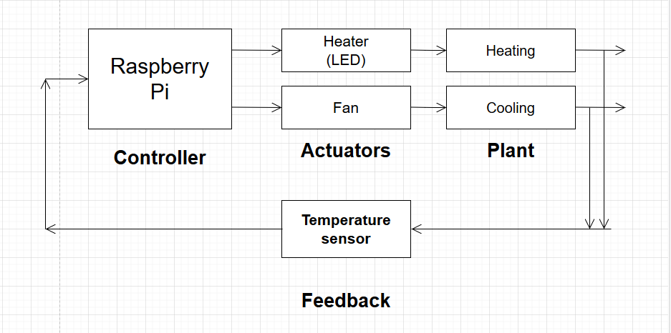
Schematics of Closed Control Systems:

Slide 6
Modeling of the system :
In this we have model the system using Finite state machine.
This FSM have three states i.e. ‘Idle’, ‘Cooling’ and ‘Heating.’
So suppose the standard temperature required is 25°C and if the temperature sensor reads temperature more than 25°C than the FAN will be ON and it will go to Cooling state.
If the temperature is equal to 25°C than it will go to Idle state.
If the temperature is below 25°C than it will go to Cooling state and LED will be ON.

Slide 7
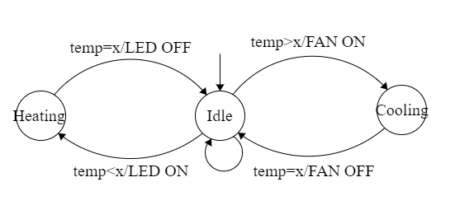
Finite State Machine :

Slide 8

Single Sensor Video Demo:

Slide 9
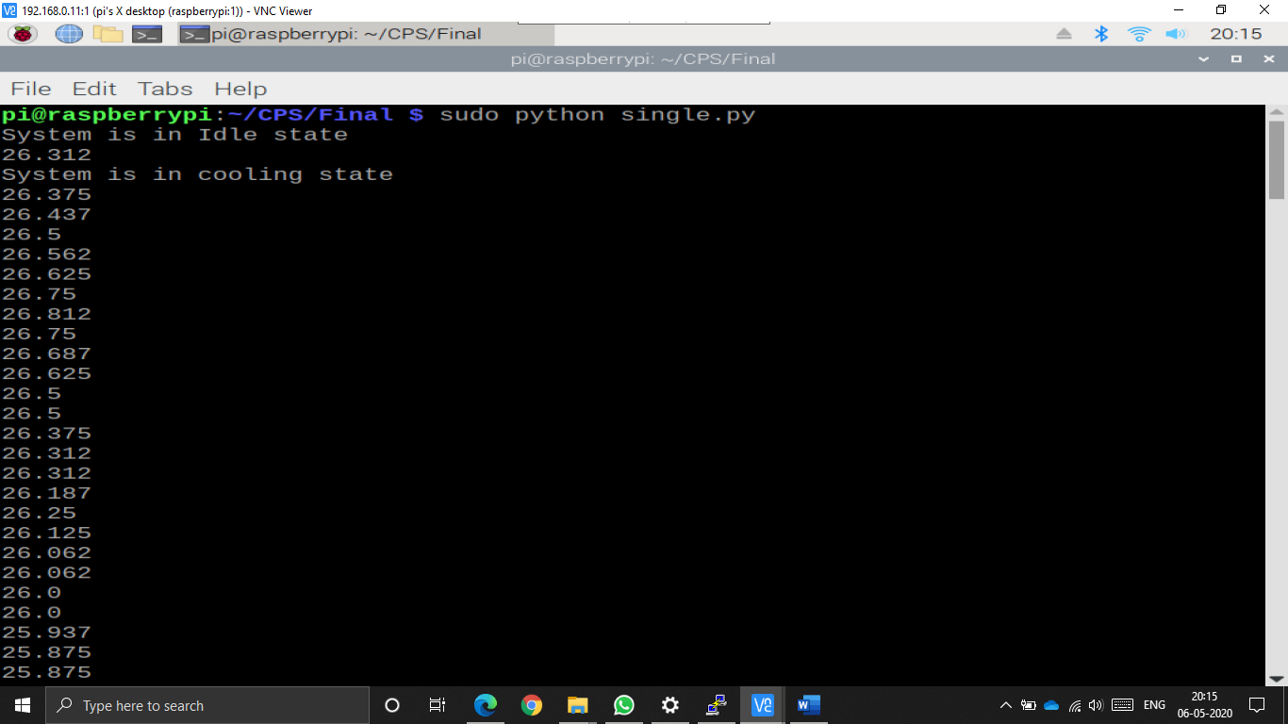
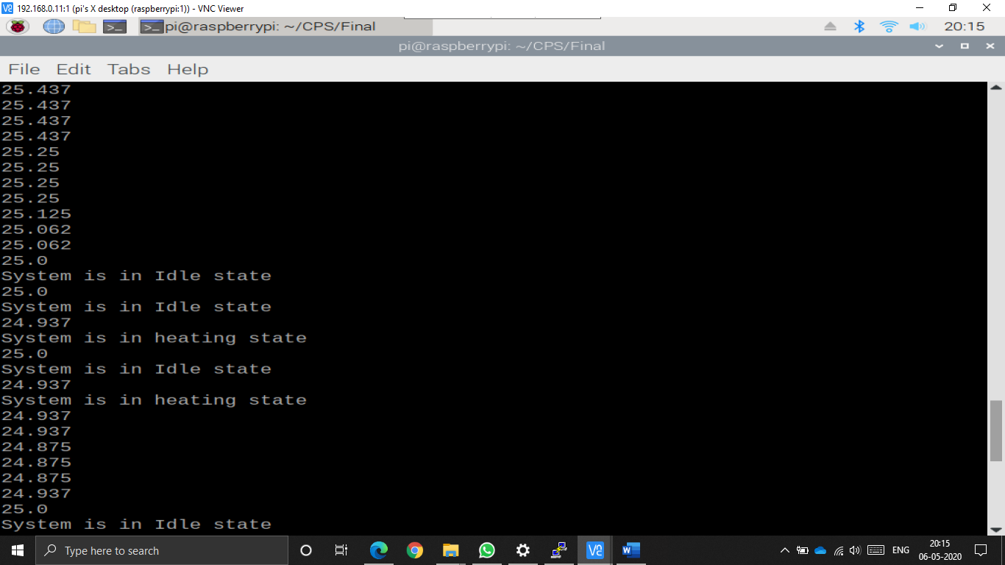
Results:

Slide 10
Modeling the system with varying Fan Speed:
In this part we decided to change the fan speed as per the temperature requirements.
So suppose the standard temperature required is 25°C and if the temperature sensor reads 26°C than the FAN will be on with duty cycle 50% (State = Cooling 1).
If the temperature is raised to 28°C than FAN speed will be increased to 75% duty cycle
(State = Cooling 2).
If the temperature is raised to 30°C than the FAN speed will be increased to 100% duty cycle
(State = Cooling 3).
Accordingly the state transitions and fan speed variation will occur depending on the temperature variation.

Slide 11
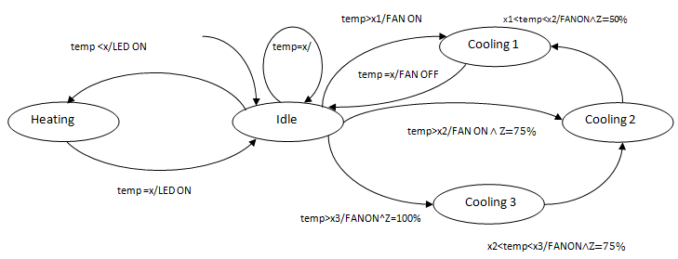
Extended FSM for varying FAN rpm :

Slide 12
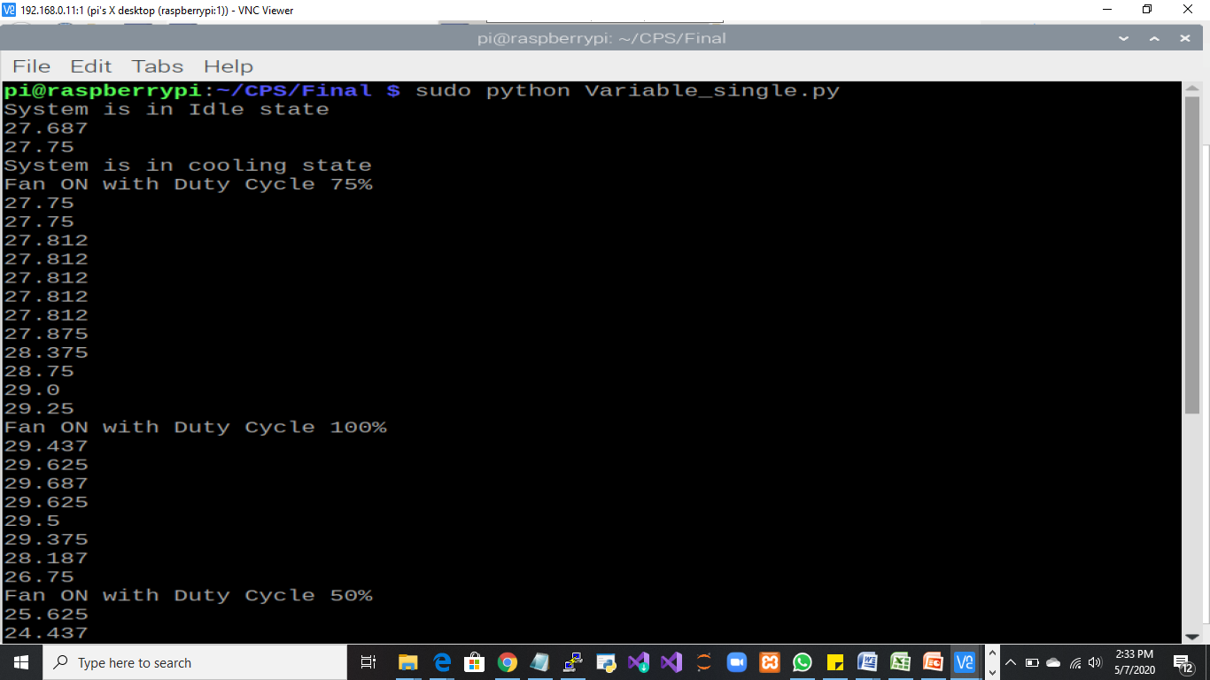
Result for varying FAN rpm :

Slide 13
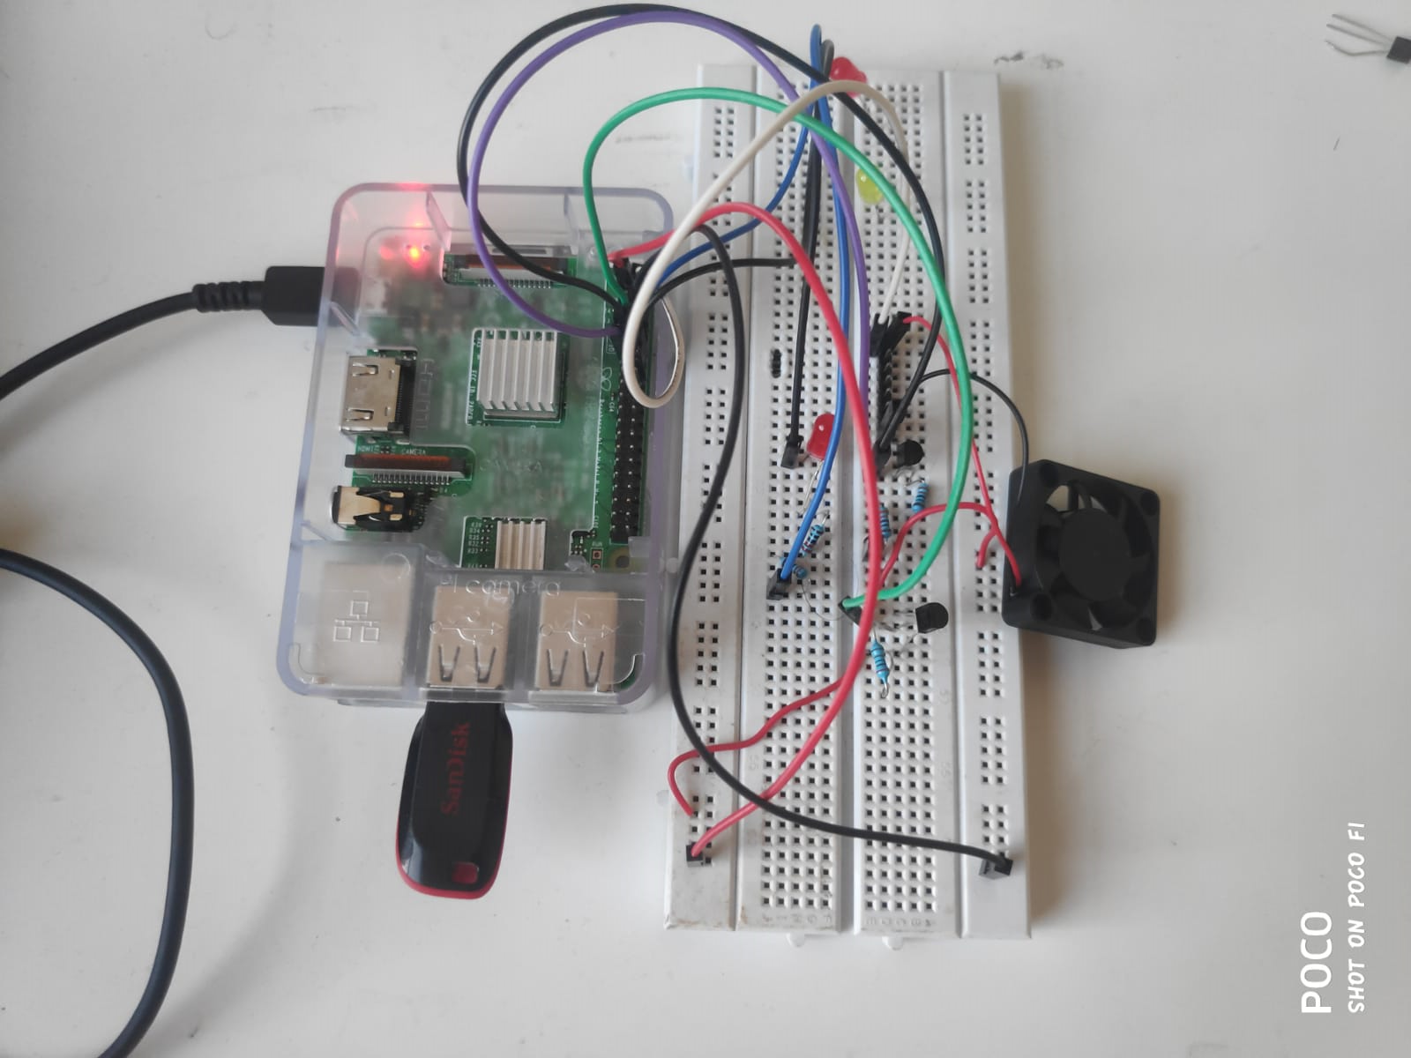
Designing the system:
We have used Raspberry Pi, temperature sensor, cooling Fan, LEDs, resistors, npn transistors and connecting wires.
Software Components includes Raspbian OS (better for scheduling), programming language-python.
The Pi's GPIO pins are only capable of supplying 3.3V and the Pi's 5V pins are connected directly to the power supply and cannot be controlled via software.
Therefore, we needed a way to power the fan using the 5V pin and switch it on and off using a GPIO pin and accordingly we used npn transistors.
The DS18B20 communicates with the “One-Wire” communication protocol, a proprietary serial communication protocol that uses only one wire to transmit the temperature readings to the microcontroller.
Using “One-Wire” protocol we can connect multiple sensors to the microcontroller.
The DS18B20 calculates the CRC value and provides it to the microcontroller, this is helpful in detecting the transmission error of the data

Slide 14
Analysis of the System :
For the analysis of the system we have used Temporal Logic to create LTL formulas which is:
G( x ==> Fy )
This is valid for all the trace of our extended FSM which will be explained in the next part.

Slide 15
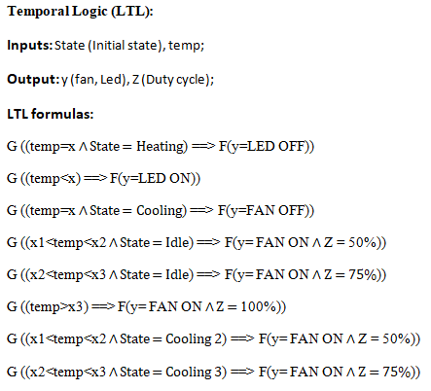
Temporal Logic: LTL formula

Slide 16
System Robustness:
The temperature monitoring systems should be robust.
Undesired temperature in the greenhouse can affect the crops.
The main causes of system failure:
Incorrect Sensor reading
Actuator falling to activate.
The robustness is increased by adding extra sensors and actuators.

Slide 17
Handling inaccurate sensor reading:
Checking the temperature value using CRC check provided by sensor
Get the reading from the 3 temperature sensor
Subtract the values from one another i.e t1-t2, t2-t3 and t3-t1 and store it in three variables a, b and c respectively.
When one of the temperature sensor is faulty either a,b or b,c or c,a will have values greater than 1.
If values a and b are greater than 1 then it means that t1 is faulty.
After determining the faulty sensor, the temperature reading from the correct sensor is taken for the rest of the process

Slide 18
Multiple Sensors Video Demo:

Slide 19
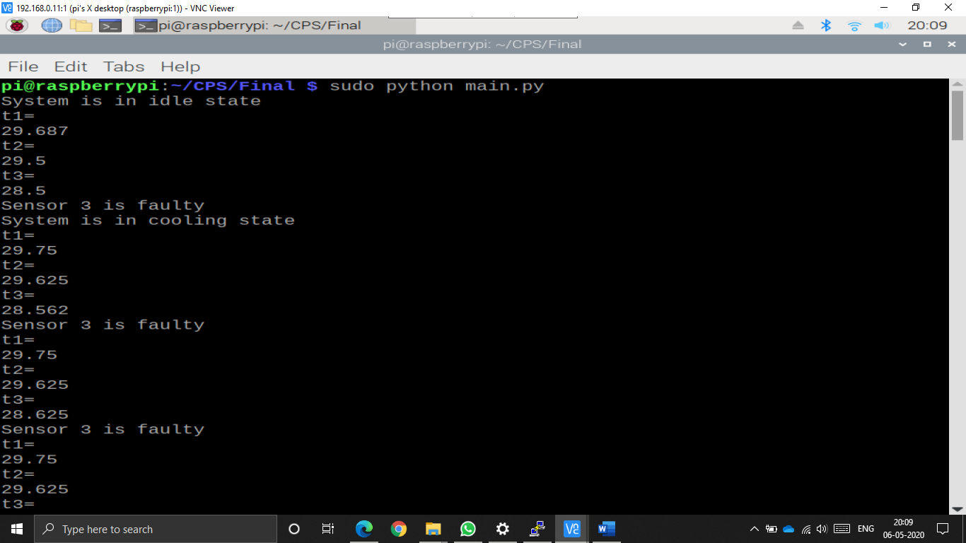
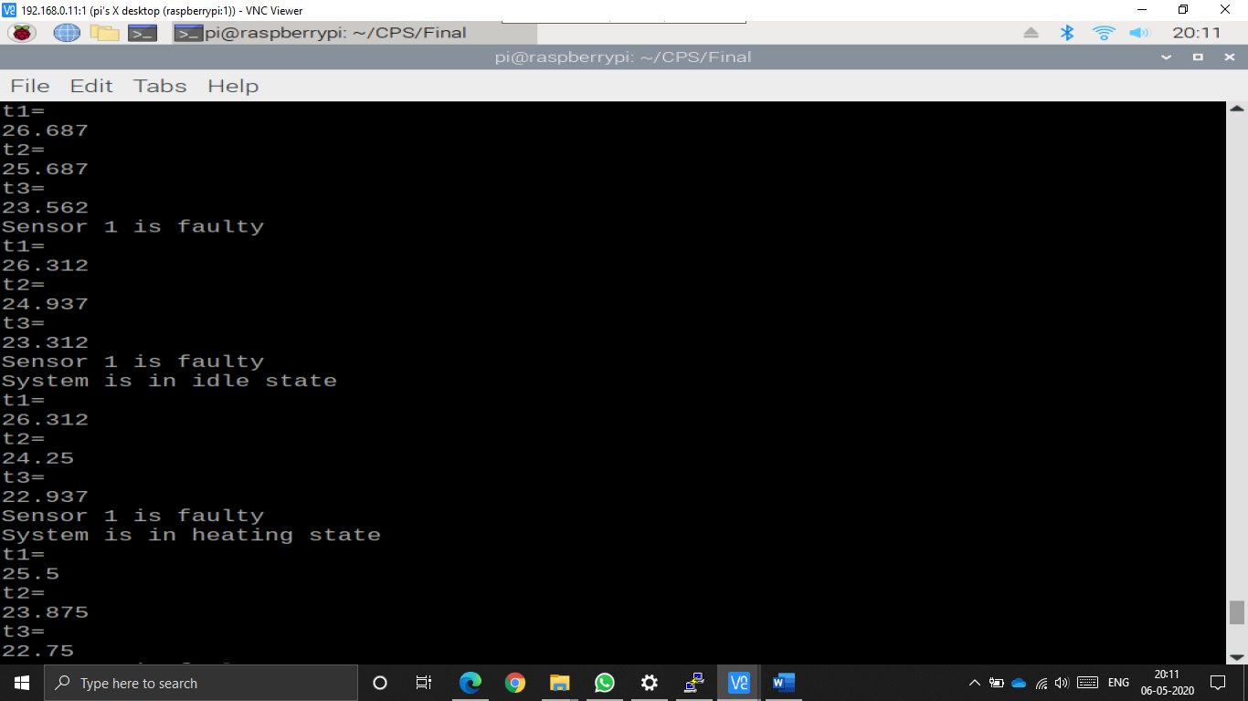
Results:

Slide 20
Handling Actuator Failures
For Fan
Calculate the average time required by the fan to reduce the temperature by 1 degree
Wait for the average time that a fan takes to reduce the temperature by 1 degree
Check if the temperature is reduced to 1 degree.
Take necessary action.
For Heater
Calculate the average time required by the heater to increase the temperature by 1 degree
Wait for the average time that a heater takes to increase the temperature by 1 degree
Check if the temperature is increased to 1 degree.
Take necessary action.

Slide 21
Actuator Behavior Analysis:
Calculated the average time required by the fan to reduce the temperature by 1 degree :
def fan_cooling(): // when temperature is greater than the ideal value turn on the fan.
GPIO.output(17, True) // Fan turned on
print "System is in cooling state"
while temp > 25 : // system should be in cooling state until ideal value is achieved.
while timer_count != 0: // wait for the average time that a fan takes to reduce the temperature by 1 degree
timer_count--
if (timer_count == 0): // reset the timer_count
timer_count = 20000
temp = read_temp()
if (temp != temp -1): // check if the temperature is reduced to 1 degree... if yes do nothing
GPIO.output(17, False) // if no... turn off fan 1
GPIO.output(18, True) // turn on fan 2
temp = read_temp() // read the temp again to check the ideal value.
GPIO.output(17, False)
GPIO.output(18, False)
idle_read()

Slide 22
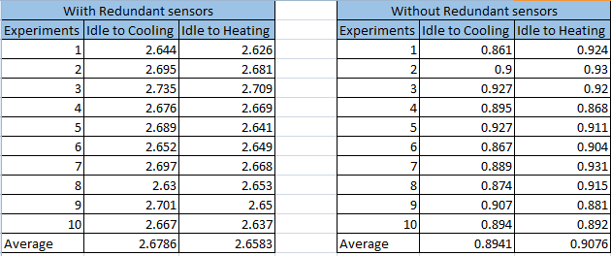
Response time of the critical part of our project:

Slide 23


